Slide 1
9-3 Rotations on the Coordinate Plane
Mrs. Taormina
Geometry C

Slide 2
Rotations
What two things do we consider in each transformation?
1.
2.
Same orientation
Rigid motion (isometric)

Slide 3
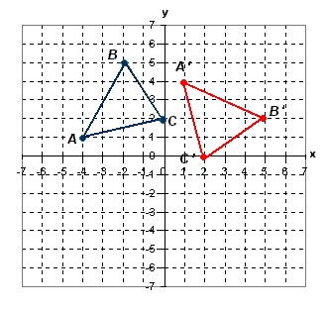
Rotation 90 degrees clockwise (or 270 degrees counterclockwise)
( a , b) → (b , -a)
A (-4, 1)
B (-2, 5)
C (0, 2)
A’ (1,4)
B’ (5,2)
C’ (2,0)

Slide 4
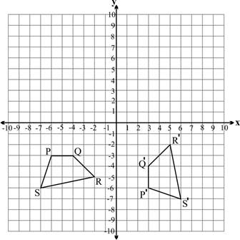
Rotation 90 degrees counterclockwise (or 270 degrees clockwise)
( a , b) → (-b , a)
P (-6, -3)
Q (-4, -3)
R (-2, -5)
S (-7, -6)
P’ (3, -6)
Q’ (3, -4)
R’ (5, -2)
S’ (6, -7)

Slide 5
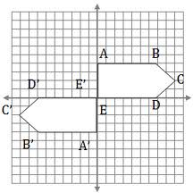
Rotation of 180 degrees
( a , b) → (-a , -b)
A (0, 4)
B (7, 4)
C (9, 2)
D(7, 0)
E (0, 0)
A’ (0, -4)
B’ (-7, -4)
C’ (-9, -2)
D’(-7, 0)
E’ (0, 0)

Slide 6
Coordinate Plane

Slide 7
HW
Complete rotations from Friday (I’d do those here)
WS-Rotations with coordinates
Pg. 566 (o = counterclockwise)
#38-47 and #59-61

