Slide 1
9-6 Dilations 9-7 Similarity Transformations
Geometry C
Mrs. Taormina

Slide 2
Dilation: Enlargement or reduction.
Dilations have a center and a scale factor.
EX.: Scale factor = 2
10
5

Slide 3
Dilations
Orientation?
Rigid Motion?
Stays the same
No, the figures are not congruent.

Slide 4
Scale factor greater than 1 = enlargement
Scale factor less than 1 = reduction
Scale factor = 1 is a congruence transformation.

Slide 5
Coordinate Example
Dilations in the coordinate plane (centered at origin):
1. Multiply each coordinate by the scale factor.
2. Each product is the coordinate of the image.
Ex.: Preimage (4, 1) with a scale factor = 5
4 x 5 = 20
1 x 5 = 5 Image = (20, 5).

Slide 6
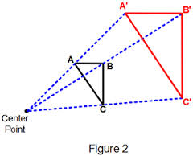
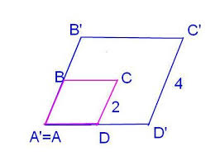
Dilations not on a coordinate plane
Center of dilation ON the figure
Center of dilation OUTSIDE the figures
The center of dilation is point A.
Side CD = 2.
The image C’D’ = 4.
The image is two times larger than the preimage, so the scale factor is 2.
Point P is the point of dilation.
PA = 3 and PA’=6
The distance from the center of dilation to the image point is twice as far as the center to the preimage point. So the scale factor is 2.
3
3
P

Slide 7
Let’s Try Some…
Find the coordinates of the image under each dilation:
A = (2, 10) B = (-4, 1) C = (-15, -9) E = (9, -1)
A’ = B’ = C’ = E’ =
(1, 5)
(-10, -6)
(18,-2)
(-12,3)

