Slide 1
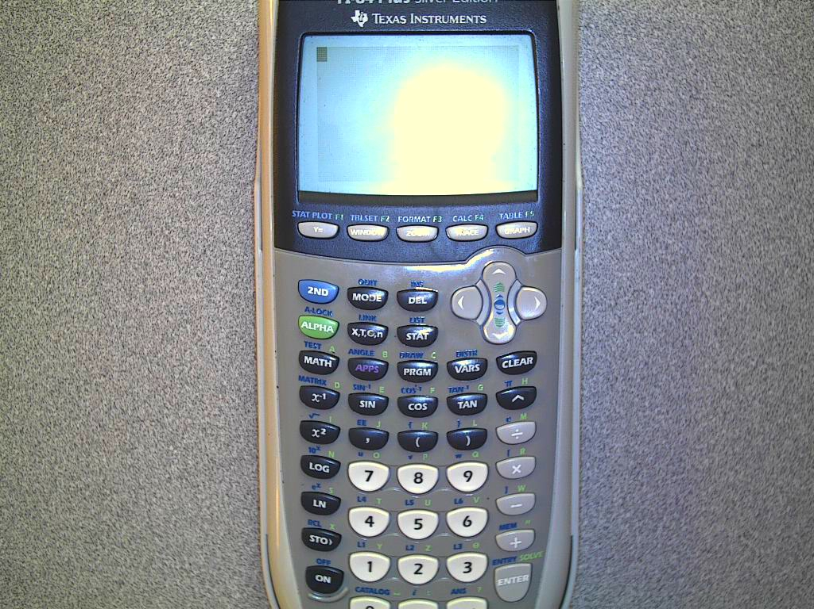
Did you know??
There are apps on your
TI-84 calculator.
One of them is an Areaform app. This will give you examples of area problems as well as “notes” on area for 6 simple figures.
Press the purple APPS key

Slide 2
Steps to see the formulas
Select #4 from the list, then press enter TWICE.
Select #1 to see all of the shapes
Pick a shape!

Slide 3
Navigation tips
The y=, WINDOW, and ZOOM keys will help you navigate the app.
y= is the MENU
WINDOW is the AREA
ZOOM is the EXAMPLE

