Slide 1
Parts of Circles Dictionary

Slide 2
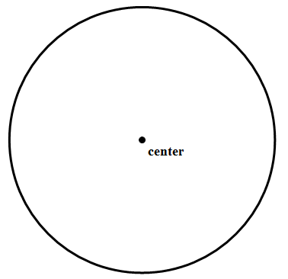
Circle
The set of points equidistant from a given point (called the center).
P

Slide 3
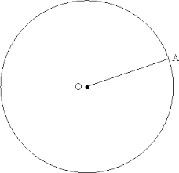
Radius
A segment with one point at the center of the circle and the other endpoint on the circle.

Slide 4
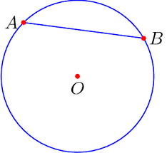
Chord
A segment with endpoints on the circle.

Slide 5
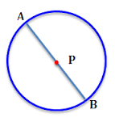
Diameter
A chord that passes through the center of the circle.
The diameter is double the size of the radius.

Slide 6
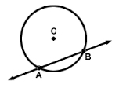
Secant
A line that intersects the circle in exactly two places.

Slide 7
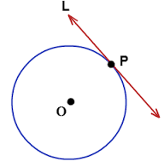
Tangent
A line that intersects the circle in exactly one point.

Slide 8
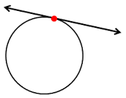
Point of tangency
The point at which a tangent line intersects the circle.
A

Slide 9
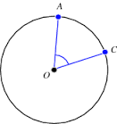
Central angle
A angle with the vertex at the center of the circle. The sides of the angle are two radii.
OA and OC are both a radius of the circle. They are the sides of angle AOC.

Slide 10
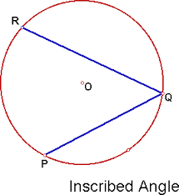
Inscribed angle
An angle with the vertex ON the circle. The two sides of the angle are chords.
RQ and PQ are chords of the circle. They are the sides of angle RQP.

Slide 11
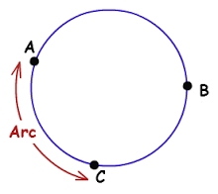
Arc
A portion of the circumference of the circle, defined by two endpoints.
The symbol is

Slide 12
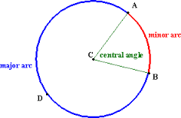
Minor arc
An arc with a measure that is LESS than 180°.
Use two letters to name the arc.
Arc AB.

Slide 13
Major arc
An arc with a measure that is GREATER than 180°.
Use THREE letters to name.
Arc ADB.

Slide 14
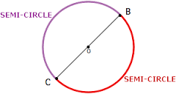
Semi-circle
An arc with endpoints that are on the diameter.
ALWAYS EQUALS 180°
Use three letters to name.

Slide 15
Area of a circle
The area is the space inside the circle.
You have to know the radius to find the area.
The formula is: A= r², where r is the radius.

Slide 16
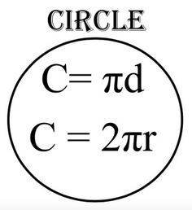
Circumference
The circumference of a circle is its perimeter.
Depending on whether you know the radius or the diameter, there are two formulas.
d = diameter
r= radius

Slide 17
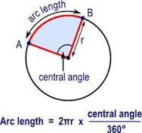
Arc length
Arc length is the measurement of a piece of the circumference of a circle.
You need to know the measure of the central angle that intercepts the arc, and you need to know the radius or the diameter of the circle.
**If you have the diameter, use instead of

